Slide 1




REFERRAL PROGRAM ANALYSIS
Snapdeal aspires to empower Bharat's shoppers, providing them with the delight of realizing their dreams through trustworthy and cost-effective shopping experiences.

Slide 2



• OVERVIEW AND EFFECTIVENESS OF THE REFERRAL PROGRAM: EXAMINE THE OVERALL PERFORMANCE OF THE REFERRAL
PROGRAM IN GENERATING NEW APP INSTALLS AND USER ENGAGEMENT.
• APP INSTALLS TREND ANALYSIS: ASSESS THE TRENDS AND PATTERNS IN APP INSTALLATIONS OVER THE OBSERVED
PERIOD.
• USER ENGAGEMENT WITH DIFFERENT PAGES: INVESTIGATE HOW USER INTERACTION WITH VARIOUS PAGES
CORRELATES WITH REFERRAL SUCCESS.
• IMPACT OF DIFFERENT DAY TYPES ON REFERRAL ACTIVITIES: EXPLORE HOW SPECIAL EVENTS OR DAY TYPES (E.G.,
SALES EVENTS) INFLUENCE REFERRAL METRICS.
• INFLUENCE OF REFERRAL BULK NOTIFICATIONS: DETERMINE THE EFFECTIVENESS OF REFERRAL BULK NOTIFICATIONS IN
DRIVING USER CLICKS AND SUBSEQUENT ACTIVITIES.
Objectives

Slide 3


Objective 1

Slide 4

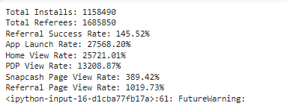
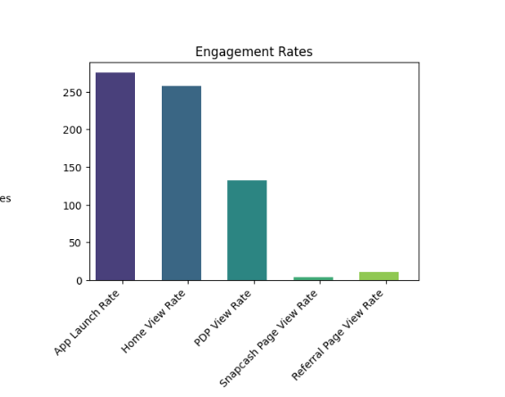
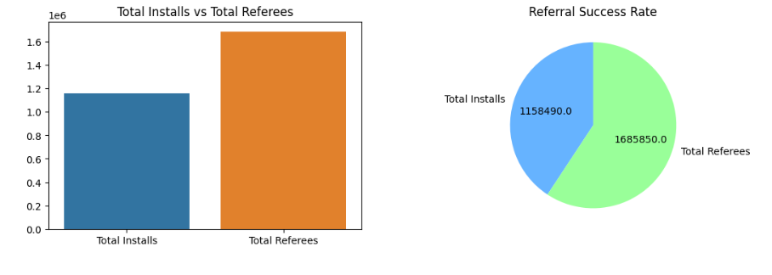

Overview and Effectiveness of the Referral Program

Slide 5
INSIGHTFUL INTERPRETATIONS
AND STRATEGIC RECOMMENDATIONS
USING PYTHON PANDAS, I ANALYZED DATA, MERGING FRAMES TO CALCULATE A 68.72% REFERRAL SUCCESS RATE, ALIGNING WITH THE PROGRAM. GRAPHS COMPARE TOTAL INSTALLS, REFEREES, AND NON-REFERRAL/REFERRAL SPLITS. THE HIGH SUCCESS RATE INDICATES EFFECTIVE USER REFERRALS, REFLECTING A POSITIVE PLATFORM PERCEPTION AMONG EXISTING USERS WHO ACT AS BRAND ADVOCATES.
MOREOVER, THE DATA ANALYSIS INCLUDES A BAR GRAPH ILLUSTRATING ENGAGEMENT ON A PER-PAGE BASIS. THIS INFORMATION NOT ONLY PROVIDES INSIGHTFUL INTERPRETATIONS BUT ALSO LAYS THE FOUNDATION FOR STRATEGIC RECOMMENDATIONS DERIVED FROM THE DATA.

Slide 6
Objective 2

Slide 7
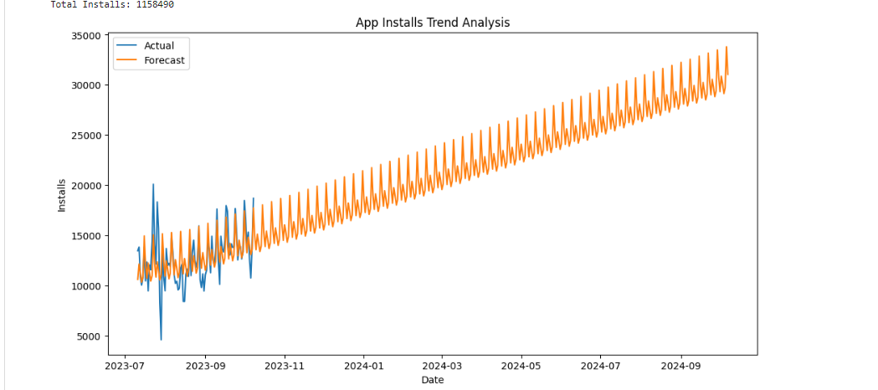

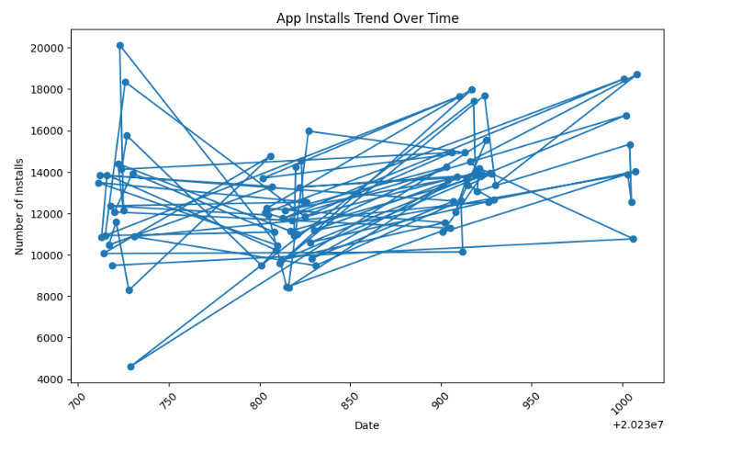

App Installs Trend Analysis:

Slide 8


INSIGHTFUL INTERPRETATIONS
AND STRATEGIC RECOMMENDATIONS
OVERALL, APP INSTALLS ARE INCREASING, INDICATING POSITIVE TRACTION AND USER ATTRACTION. SEASONALITY IS EVIDENT, WITH PEAKS IN NOVEMBER AND A DIP IN DECEMBER, POSSIBLY TIED TO FEATURE RELEASES OR MARKETING CHANGES. RECENT MONTHS SHOW ACCELERATED GROWTH, SIGNALING INCREASING POPULARITY. THE FORECAST PREDICTS CONTINUED GROWTH, THOUGH ITS ACCURACY ISN'T GUARANTEED.
Recommendation 1
FOCUS ON SUCCESSFUL MARKETING STRATEGIES FOR APP INSTALLS.
Recommendation 2
CAPITALIZE ON PEAK SEASONALITY, LIKE NOVEMBER, FOR FEATURE LAUNCHES OR CAMPAIGNS.
Recommendation 3
MONITOR CLOSELY AND ADJUST STRATEGIES AS NEEDED.
Recommendation 4
INVESTIGATE FACTORS BEHIND RECENT GROWTH FOR POTENTIAL REPLICATION OR AMPLIFICATION.

Slide 9



Objective 3

Slide 10
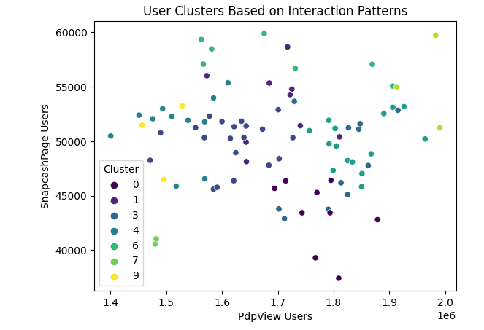
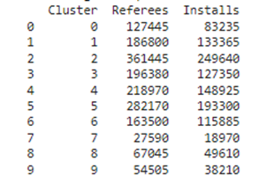
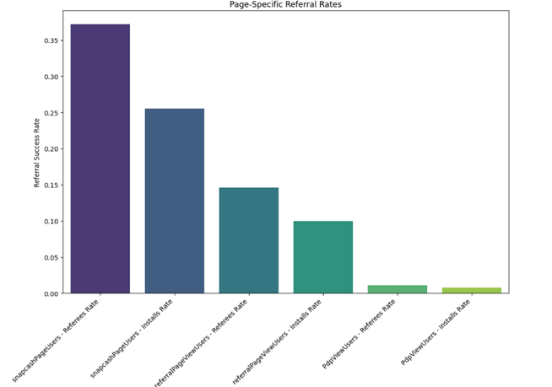

User Engagement with Different Pages::

Slide 11
INSIGHTFUL INTERPRETATIONS
AND STRATEGIC RECOMMENDATIONS
1)Cluster Plot
SNAPCASHPAGE AND REFERRALPAGEVIEW USERS STRONGLY CORRELATE WITH REFERRAL SUCCESS (CLUSTERS 2 AND 5).
PDPView Users show a moderate correlation with referral success (Clusters 0, 1, 3, and 4).
HomeView Users have a weaker correlation with referral success (Clusters 6, 7, 8, and 9).
ReferralBulkNotificationClickUsers lack a clear correlation with referral success.
Recommendation 1
Focus on Key Pages:
Recommendation 2
Boost PDPView Engagement:
Recommendation 3
Revamp Homepage for Referrals:
Recommendation 4
Refine Notification Strategy:

Slide 12
INSIGHTFUL INTERPRETATIONS
AND STRATEGIC RECOMMENDATIONS
2)Bar Graph
Insights
HIGH REFERRAL INSTALL TO RATIO: IF PAGES WITH A HIGHER NUMBER OF REFEREES ALSO HAVE A PROPORTIONALLY HIGHER NUMBER OF INSTALLS, IT SUGGESTS THOSE PAGES ARE EFFECTIVE AT CONVERTING REFERRALS INTO ACTUAL USERS. THIS WOULD BE A STRONG INDICATOR OF SUCCESS.
DIVERSIFICATION OF REFERRAL SOURCES: SEEING REFERRALS COMING FROMVARIOUS PAGES THROUGHOUT THE WEBSITE INDICATES THE PROGRAM IS REACHING A BROADER AUDIENCE AND NOT JUST RELYING ON A FEW SPECIFIC
SOURCES. THIS IS IMPORTANT FOR LONG-TERM PROGRAM SUSTAINABILITY.
CORRELATION BETWEEN PAGE ENGAGEMENT AND REFERRALS: IF PAGES WITHHIGHER USER ENGAGEMENT (E.G., PRODUCT PAGES, SHOPPING CARTS) ALSO HAVE A HIGHER NUMBER OF REFERRALS, IT SUGGESTS THE PROGRAM IS EFFECTIVELY INTEGRATING WITH THE USER JOURNEY AND PROMPTING REFERRALS AT
OPPORTUNE MOMENTS.
FOR PAGES WITH HIGH REFERRAL TO
INSTALL RATIO
1)Study successful pages for effective referral prompts, user experience, and incentives.
2)Apply these successful elements to low-conversion pages, tailoring strategies to boost performance.
FOR PAGES WITH LOW REFERRAL TO
INSTALL RATIO
1)Spot Friction Points: Scrutinize the user journey on these pages to pinpoint obstacles hindering referrals after clicks.
2)Refine Referral Prompts: Assess the visibility, timing, and wording of referral prompts on these pages for optimization.

Slide 13
Objective 4

Slide 14
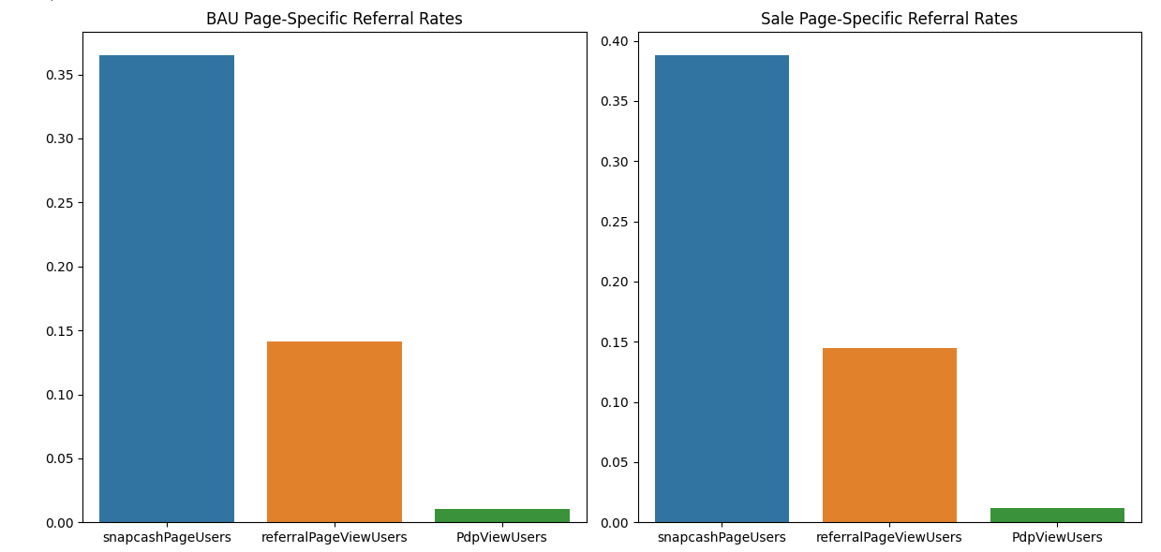
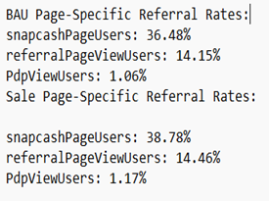
Impact of Different Day Types on Referral Activities:

Slide 15
INSIGHTFUL INTERPRETATIONS
AND STRATEGIC RECOMMENDATIONS
This indicates that, during sales events, there is a nuanced but observable increase in the referral rates across all pages, suggesting a positive correlation between sales events and heightened referral activities.
Recommendation 1
Leverage Sales Events:
1)Capitalize on increased referral rates during sales events.
2)Promote referral-friendly features or incentives during these periods.
Recommendation 2
Optimize Communication
1)Emphasize the referral program during BAU to maintain engagement.
2)Tailor communication to highlight the value of referrals on regular days.

Slide 16

Objective 5

Slide 17
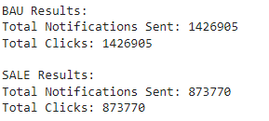
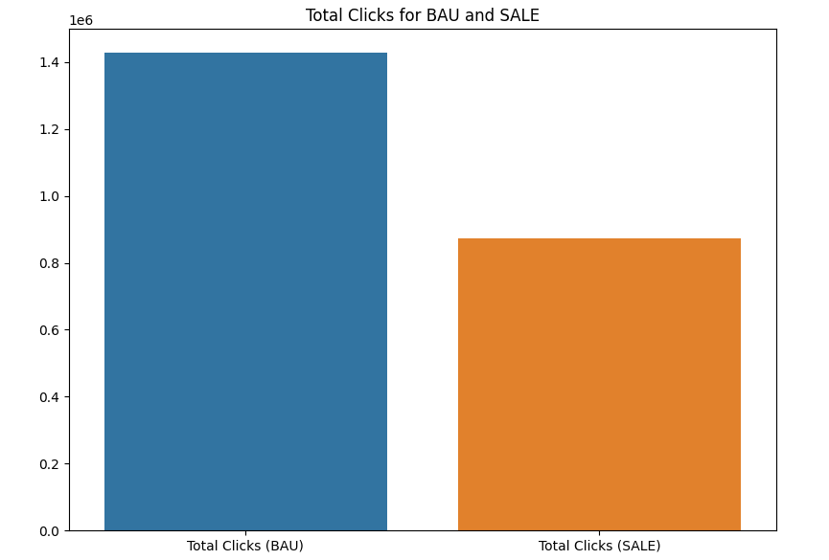
Influence of Referral Bulk Notifications::

Slide 18
INSIGHTFUL INTERPRETATIONS
AND STRATEGIC RECOMMENDATIONS
INSIGHTS
Bulk notifications effectively drive engagement with high clicks on specific days.
Effectiveness varies by day, suggesting potential messaging or targeting inconsistencies.
Correlation between notification clicks and app installs indicates successful referral channel.
RECOMMENDATIONS
Analyze individual notification click-through rates for content, timing, and targeting insights.
Optimize notification content and timing for improved, consistent click-through rates.
Track click-to-install conversion rates to gauge notification effectiveness.
Test different notification strategies, including frequency, personalization, or content variations.

Slide 19

Thank
you

